Slide 1
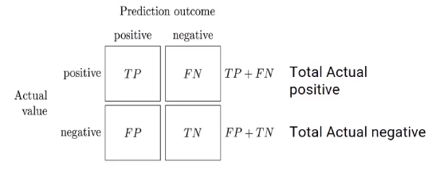
TP
TPR (True Positive Rate) = -----------
TP + FN
FN
FNR (False Negative Rate) = -----------
TP + FN
TN
TNR (True Negative Rate) = -----------
FP + TN
FP
FPR (False Positive Rate) = -----------
TP + FN

